Slide 1
Serious Games and AI
Intro to AI Part 2 – AI + Games
Summer 2021
Notes:
1
1
Check distro statement before using:
DISTRIBUTION STATEMENT A. Approved for pubic release: distribution is unlimited.
This material is based upon work supported under Air Force Contract No. FA8721-05-C-0002 and/or FA8702-15-D-0001. Any opinions, findings, conclusions or recommendations expressed in this material are those of the author(s) and do not necessarily reflect the views of the U.S. Air Force.
© 2021 Massachusetts Institute of Technology.
Delivered to the U.S. Government with Unlimited Rights, as defined in DFARS Part 252.227-7013 or 7014 (Feb 2014). Notwithstanding any copyright notice, U.S. Government rights in this work are defined by DFARS 252.227-7013 or DFARS 252.227-7014 as detailed above. Use of this work other than as specifically authorized by the U.S. Government may violate any copyrights that exist in this work.

Slide 2
Overview
Games and AI
Why games are good for stuff
Recent advancements
Traditional game AI
Non-player characters (NPC)
Pathing
AI as game analysis tools
“Solving” the game
Finding good Strategies
Finding modeling errors

Slide 3
Why Games?
Reinforcement Learning data requirements
A game is a good environment for RL
No labeled truth for direct supervised learning (well, kind of)
Other ML techniques (clustering, dimensionality reduction) are useful too
Clarity and Simplicity (compared to the real world)
Rewards are well structured and clear
Action space can be restricted
State space can be controlled
Speed
Games can run faster than real time (speeds up training)
Benchmarking
Games can be used as standard environments for judging algorithms

Slide 4
With AI, Why Still have Human Players?
Cannot fully abstract humans away
Most models of human behavior are not that great
Insights into human decision making
Games as a sensor, AI as an analysis tool
Often times we want to gain insights from humans
A complementary mixture
Keep humans around for what they are best at
Allow machines to shine where they are best
ML warm start
Jumpstart ML algorithms
Generate data
Provide labels for existing data

Slide 5
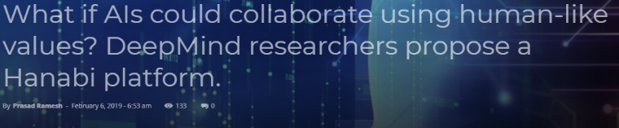
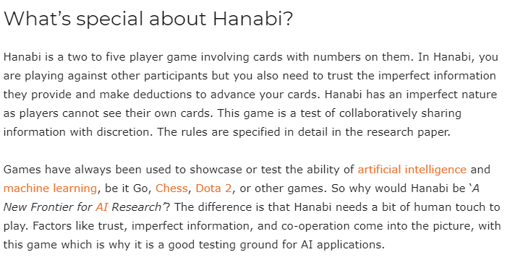
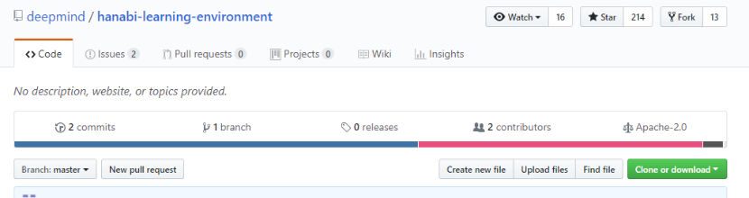
Recent Advancements
Frontier of AI/ML is overflowing into gaming
RL beyond the pixel (Deepmind, Hanabi, Starcraft, Poker, Diplomacy)
Optimal play and strategies
Test bounds of game (AI vs AI play)
Augment data
Realistic opponents (controlled data collection)
Developing decision support algorithms
Check it out yourself on github!
Notes:
The Hanabi Challenge: A New Frontier for AI Research - https://arxiv.org/pdf/1902.00506.pdf
https://hub.packtpub.com/what-if-ais-could-collaborate-using-human-like-values-deepmind-researchers-propose-a-hanabi-platform/

Slide 6
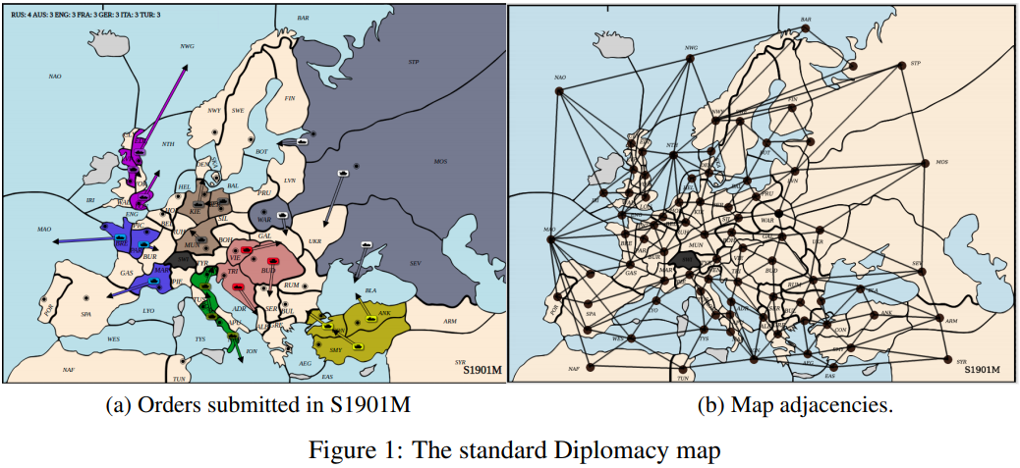
Recent Advancements
Developing AI algorithms
Shifting from zero sum to collaboration
Human Machine Teaming
Collaborative Robotics
Team problem solving
Cognitive Gaming Experiments
Testing cognitive concepts related to games
Games as experiments for human factors analysis
Software that teaches you how to use it in situ
Games for basic cognitive research
Bounds on cognitive / indicators of overload
Situational awareness maintenance and transfer
https://papers.nips.cc/paper/8697-no-press-diplomacy-modeling-multi-agent-gameplay.pdf
Notes:
Testing cognitive concepts related to games
E.g. Testing the limits of framing
Change the title of the prisoner’s dilemma game, observe player behavior changes
Lie about payoff table, observe player behavior changes

Slide 7
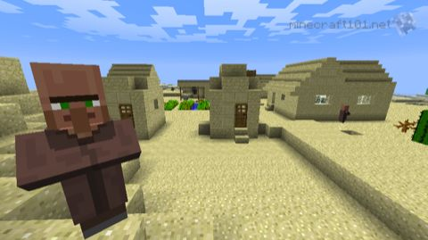
Traditional Game AI: NPCs
Non-playable characters (NPCs)
Usually the first thing that comes to mind when they hear AI in gaming
It’s not… wrong to say this is AI in gaming
Often utilizes many ML and graph models for AI behavior
But… the focus is improving the gameplay experience rather than analysis
Popular methods:
Monte Carlo Tree Search
Pathfinding (A* and the like)
State Machines (typically finite)
Composer Systems
Notes:
http://www.minecraft101.net/r/villages.html

Slide 8
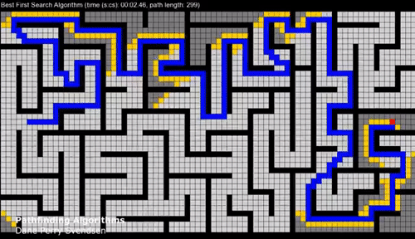
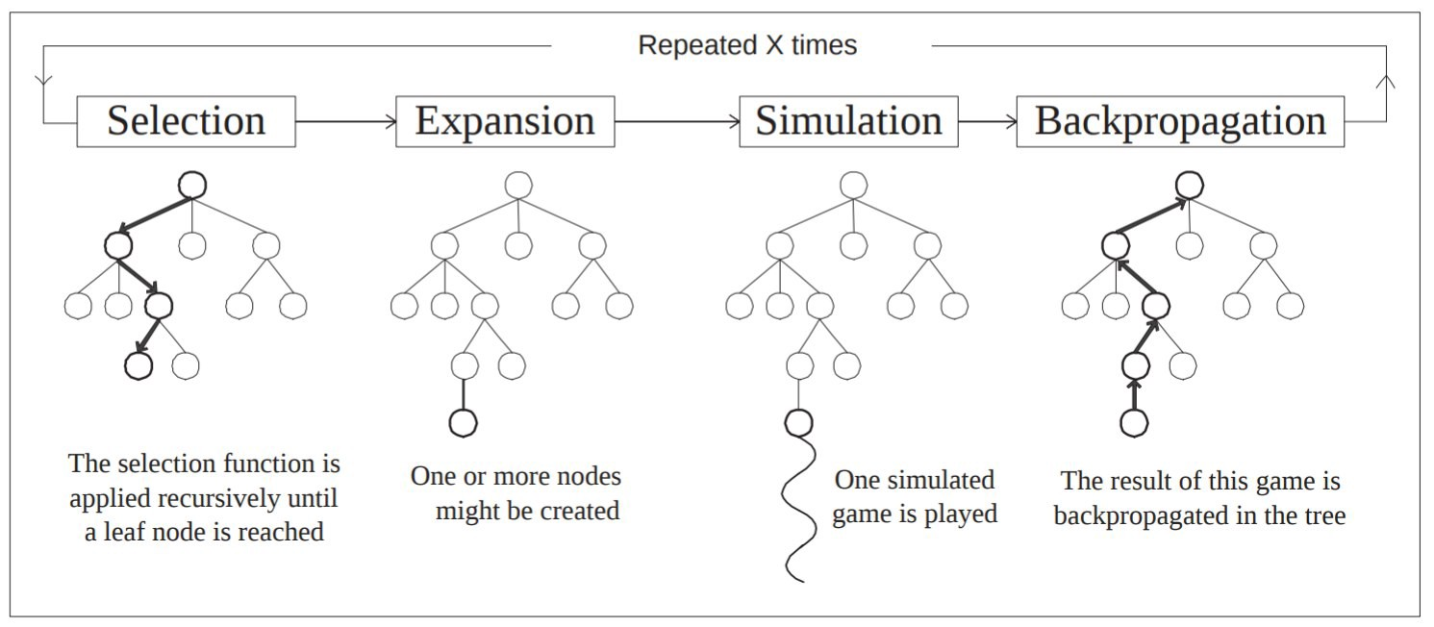
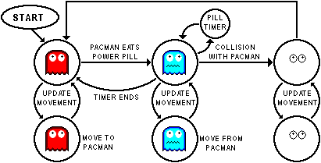
Traditional Game AI
Pathfinding
Finite State Machine
Monte Carlo Tree Search
Notes:
https://blog.baxi.taxi/using-finite-state-machines-in-baxis-ride-booking-system-126c52952a04
https://gfycat.com/thesesarcasticcrownofthornsstarfish

Slide 9
AI for Game Data Analysis
Our focus is to use AI as an analysis tool
NOT for developing AI
NOT for entertainment purposes
Games as part of the research process
Research question and hypothesis drives what data needs to be collected
Games can be a good means of collecting data from humans
Especially if we are concerned with human decision making
Analyzing the data provides insights into the research question
When doing research with games, when is AI the right tool?
“Solving” the game
Finding new strategies
Finding modeling errors

Slide 10
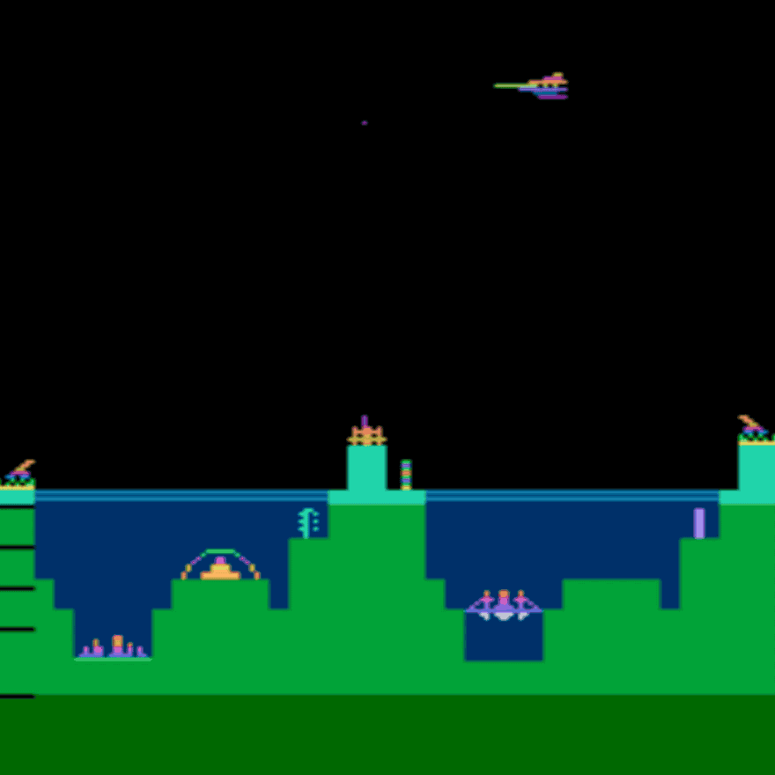
“Solving” the Game
Solving can mean a number of things but typically is used to mean:
Finding optimal strategies
May not always be possible
Provides baselines
Player Performance
Algorithm Performance
Super human performance
Using these methods to analyze data
Useful comparisons
Objective baselines
Exploration into game fundamentals
Notes:
https://towardsdatascience.com/atari-solving-games-with-ai-part-2-neuroevolution-aac2ebb6c72b

Slide 11
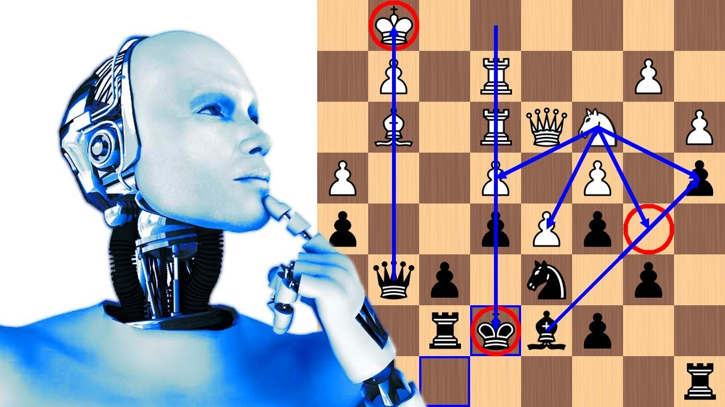
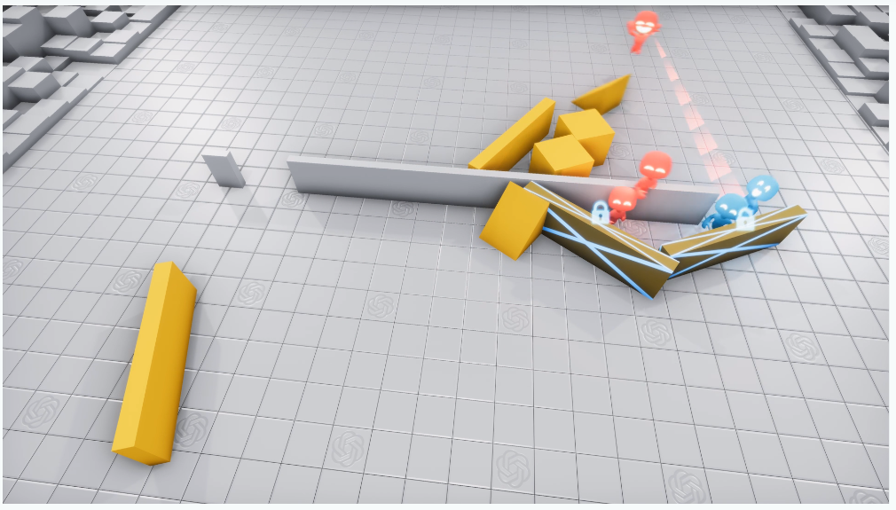
Finding Interesting Strategies
Explore strategies that humans and analysts didn’t expect
Compare strategies from different groups
Find good strategies without human players
Notes:
https://openai.com/blog/emergent-tool-use/
https://images.app.goo.gl/D7Hex528k2RqZ6DC9

Slide 12
Finding Modeling Errors
Validate correctness of your model
Show how well expert strategies perform
See how the model performs under variable conditions
Investigate how and when the model differs from reality
Find degenerate strategies
Provides game balance
Highlights issues with in-game incentives
Ensure game rules support key environment factors
Reduces cheating and exploitation

Slide 13




